Slide 1

DLM
Rated #1
‘driving lesson marketplace’
out there

Slide 2
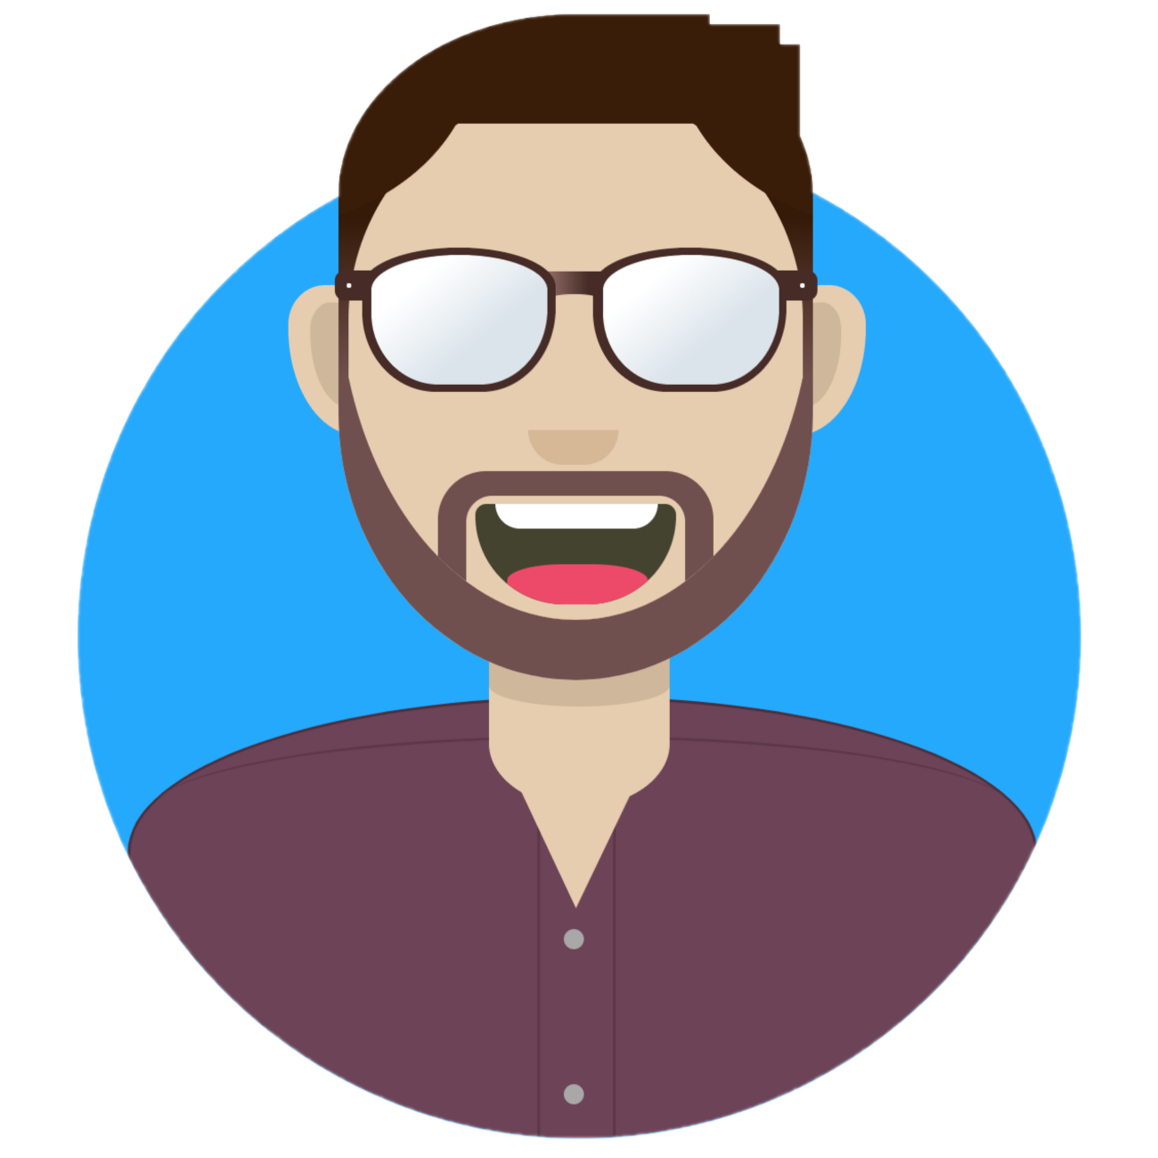
Hello!
I am Simon Curran
I am here because I copied a presentation theme.
You can find me at @simo_sultan

Slide 3
1. The Problem
Something you didn’t know you had.

Slide 4
I hear you asking that you wanted a 15th way to book a driving lesson.
Well I am here to rescue that thought.

Slide 5
What DLM says you want
You want to not call a driving school
You want to book a lesson with a stranger
You want proof of you meeting said stranger
The stranger needs to see where you live so they can come to your place
The stranger needs your phone number so he can call you at any time
And someone who works for DLM wants to watch all this happen

Slide 6
Your Solution
That doesn’t involve calling the cops.

Slide 7
DLM is here to save the day
You can input all your personal details
You get to upload a photo of yourself so other people can judge you
The stranger will arrive at your requested date and time
The stranger will tell you to do stuff for your requested duration
The stranger can cancel your meeting at any time
And the person at DLM can change and delete your proof of meeting at any time

Slide 8
Why choose us?
We pinky swear to never sell your data. And we have plenty of instructors because we don’t check their licenses or blue cards.

Slide 9
We have strangers in every continent that isn’t marked with an ‘X’
our office

Slide 10
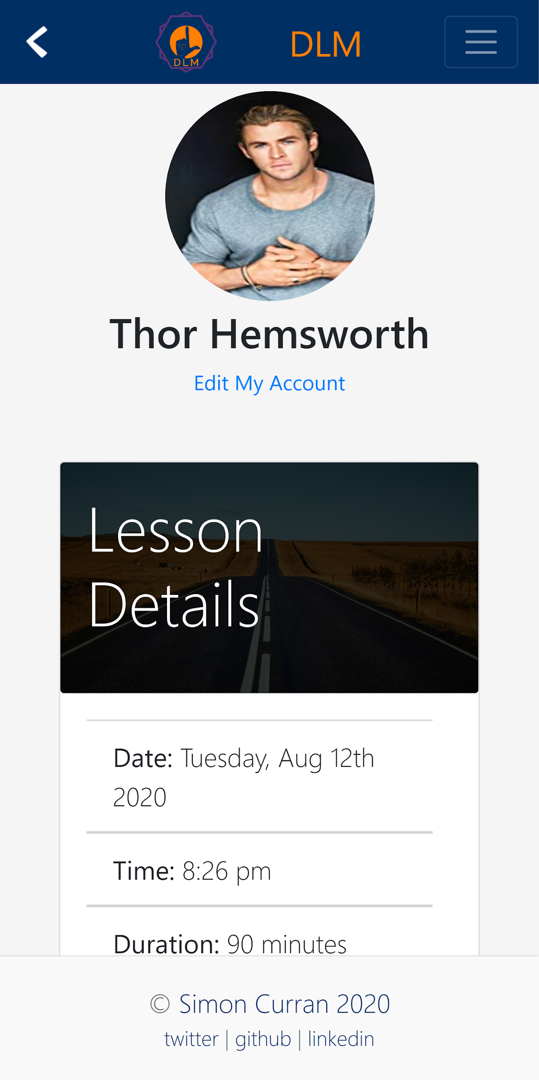
Mobile
This is how we track you on your phone.

Slide 11
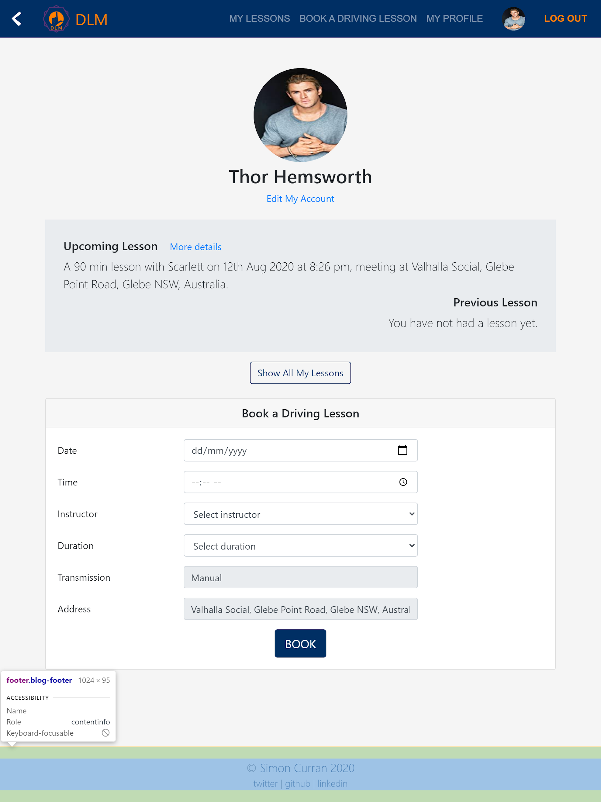
Tablet
And on your tablet.

Slide 12
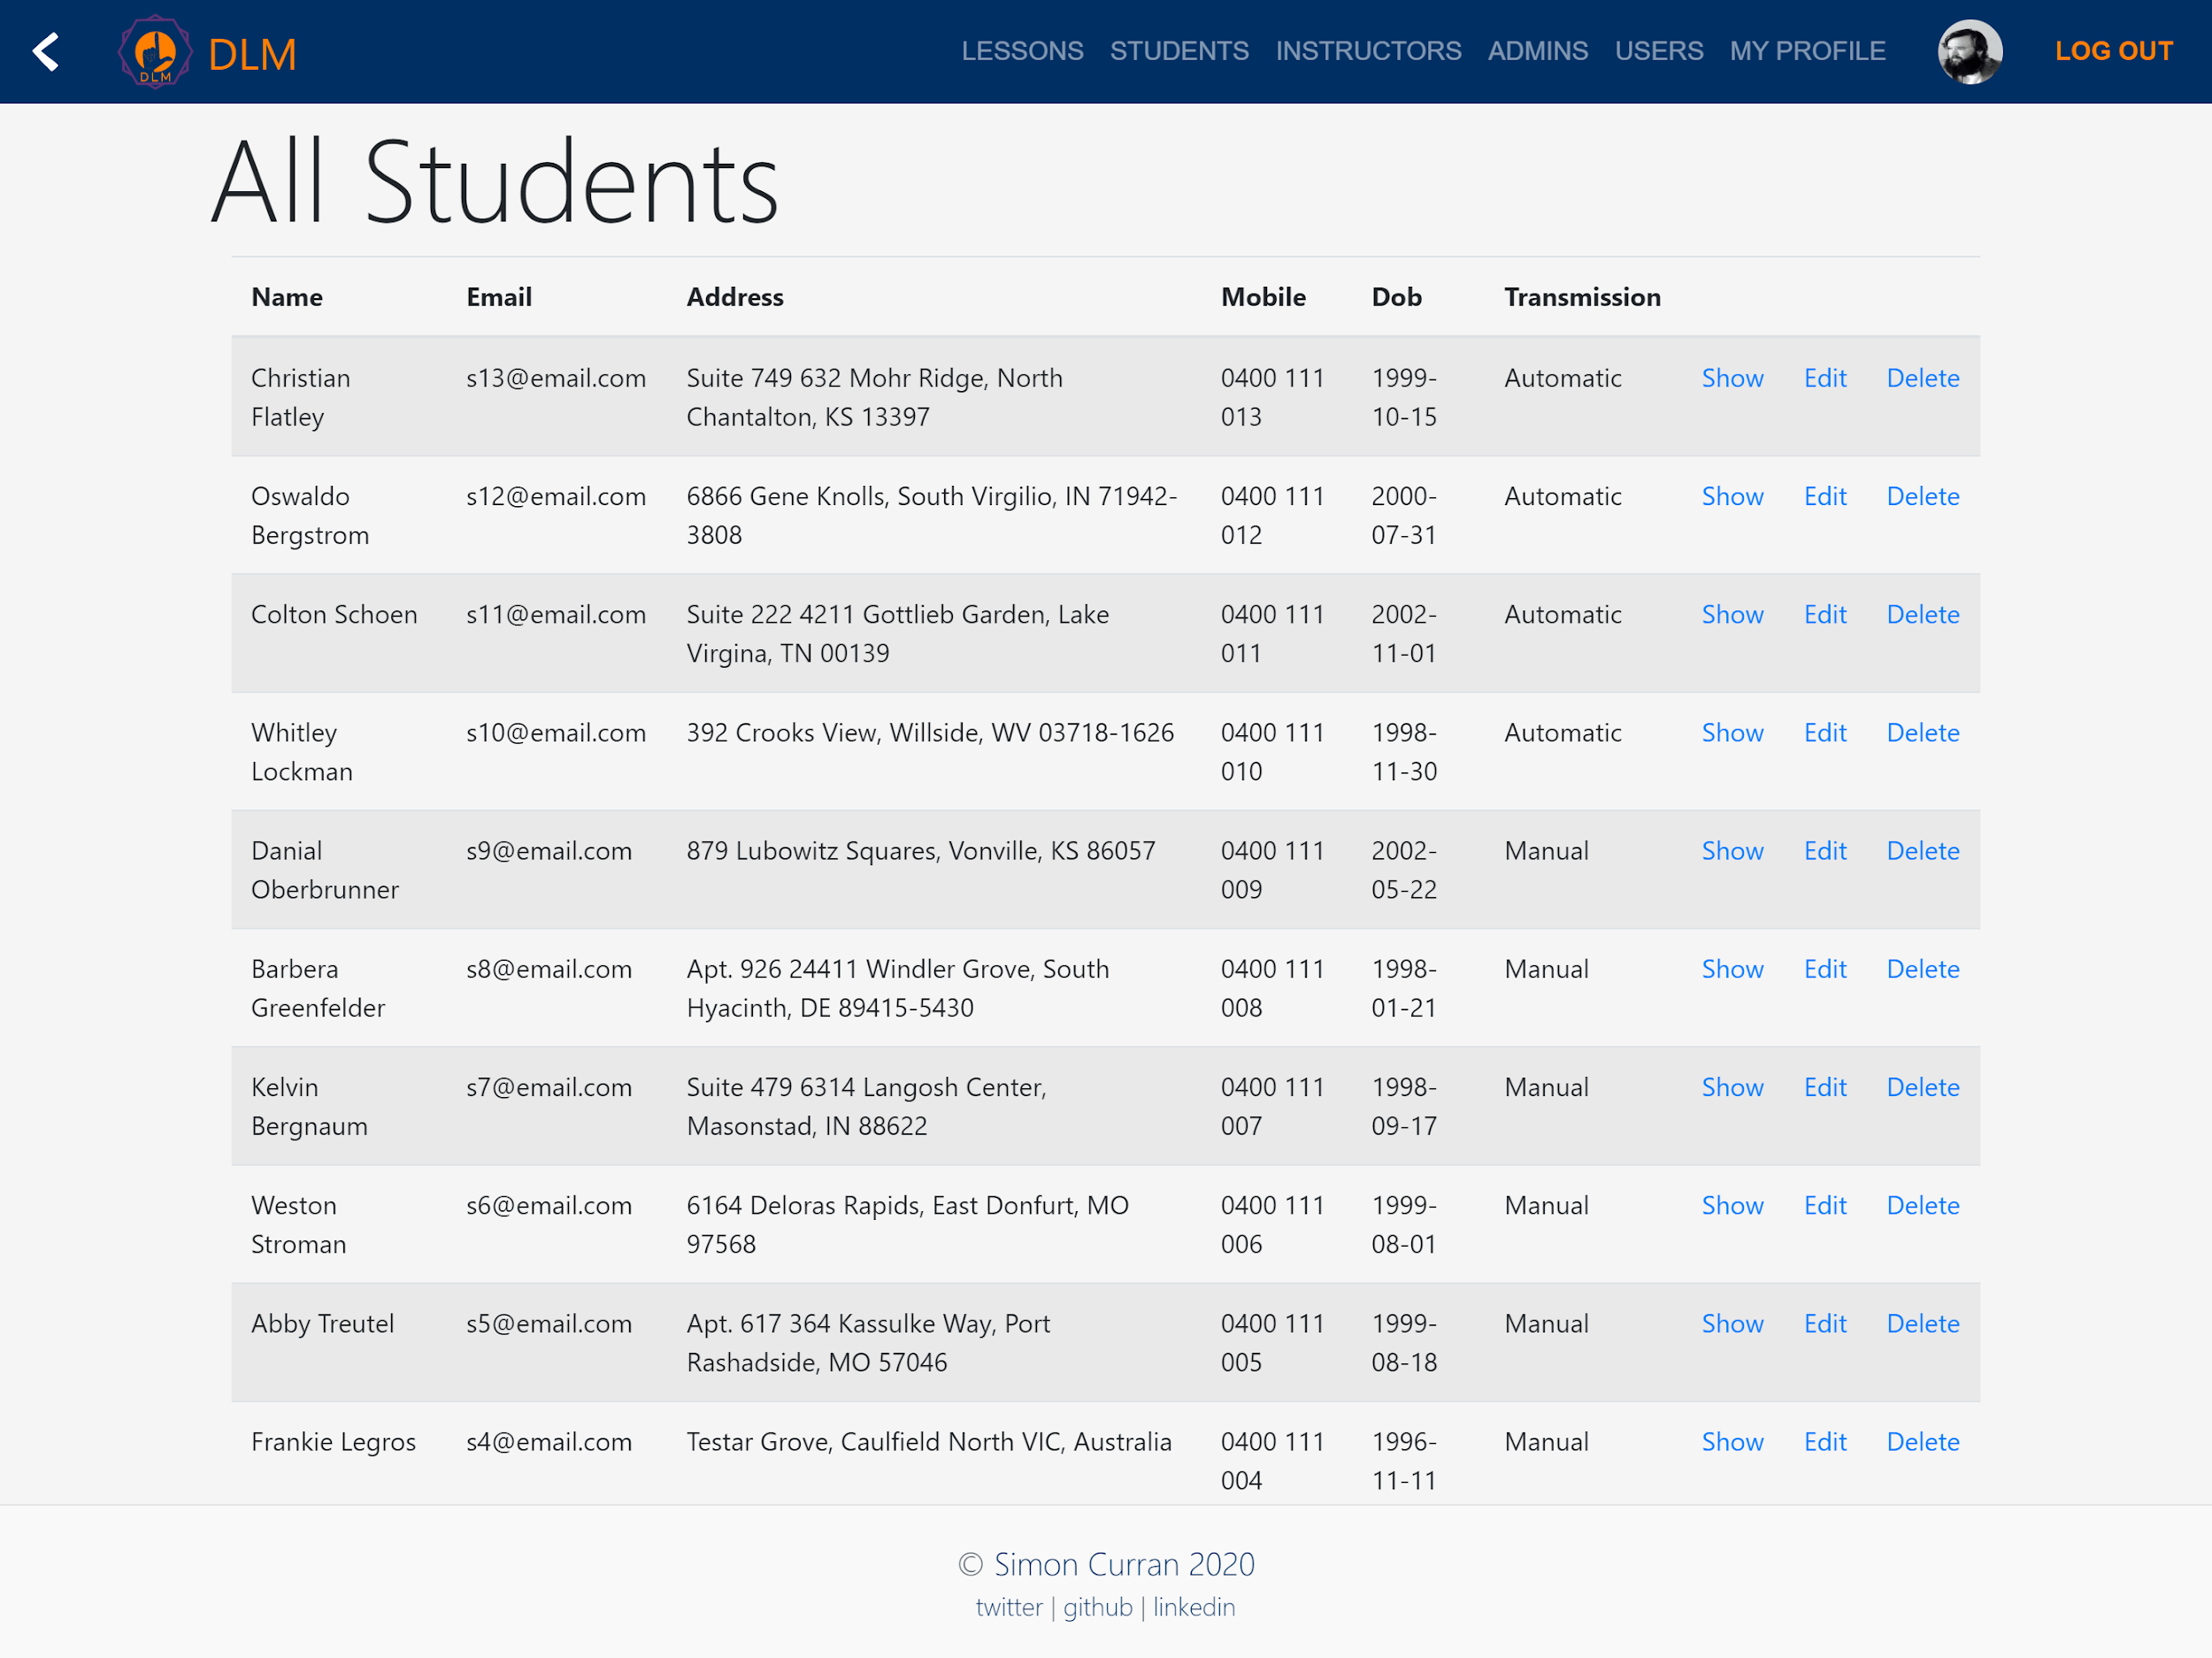
Desktop
Here too.
Place your screenshot here

Slide 13
Спасибо!
Any questions?
You can email us at:
no-reply@gmail.com

